Slide 1
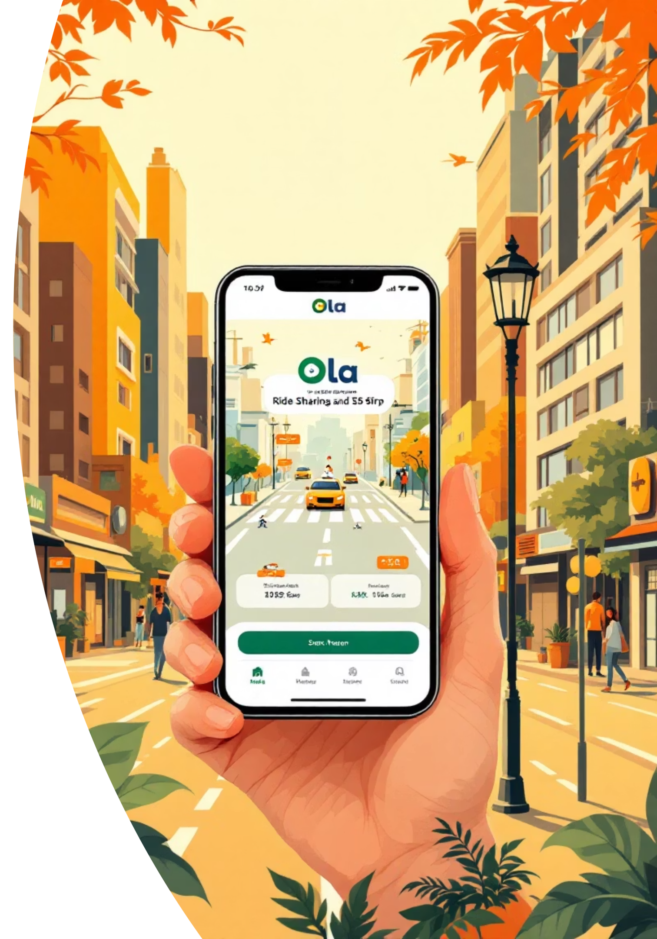
Ola Ride Analytics
Analyzing 71,202 ride bookings to uncover patterns in customer behavior, vehicle preferences, and operational efficiency.

Slide 2

Dataset Overview
Dataset Size
Key Data Points
71,202 booking records with 20 columns capturing comprehensive ride information.
Booking status, vehicle type, locations, ratings, payment methods, and cancellation reasons.
Data Quality
Cleaned and validated; null values in ratings for canceled/incomplete rides; integrated into SQL database.

Slide 3

Data Preparation Process
01
Initial Loading
Imported uncleaned Excel file into spreadsheet tool for processing.
02
Redundancy Removal
Eliminated duplicate cancellation columns; replaced vehicle image URLs with standardized format.
03
Data Retention
Preserved all 71,202 rows and core booking columns for analysis integrity.
04
Integration
Exported cleaned dataset and loaded into ola_bookings SQL table for querying.

Slide 4

Successful Bookings & Vehicle Performance
Successful Bookings
Average Ride Distance by Vehicle
SQL view created to isolate all rides with "Success" status, enabling focused analysis of completed transactions and revenue patterns.
Query calculates mean distance for each vehicle type, revealing usage patterns and fleet optimization opportunities.

Slide 5

Cancellation Insights
Customer Cancellations
Driver Cancellations
Personal and car-related issues account for significant driver-initiated cancellations, impacting service reliability.
Tracked total rides canceled by customers to identify behavior patterns and "change of plans" trends.
Incomplete Rides
Documented all incomplete rides with reasons to address operational gaps and improve completion rates.

Slide 6

Customer & Driver Ratings
4.0
3.99
4
Prime Sedan
eBike
Overall Average
Highest average customer rating across vehicle types.
Lowest average customer rating; opportunity for service improvement.
Consistent 4.0-star ratings across all vehicle categories indicate strong service quality.

Slide 7

Top Customers & Revenue
Top 5 Customers
Total Booking Value
CID340854 leads with 4 bookings; CID463543, CID657000, CID356460, and CID896927 each booked 3 rides. High-value segment for retention strategies.
Successfully completed rides generated substantial revenue. Payment method analysis shows UPI dominance in successful transactions.

Slide 8
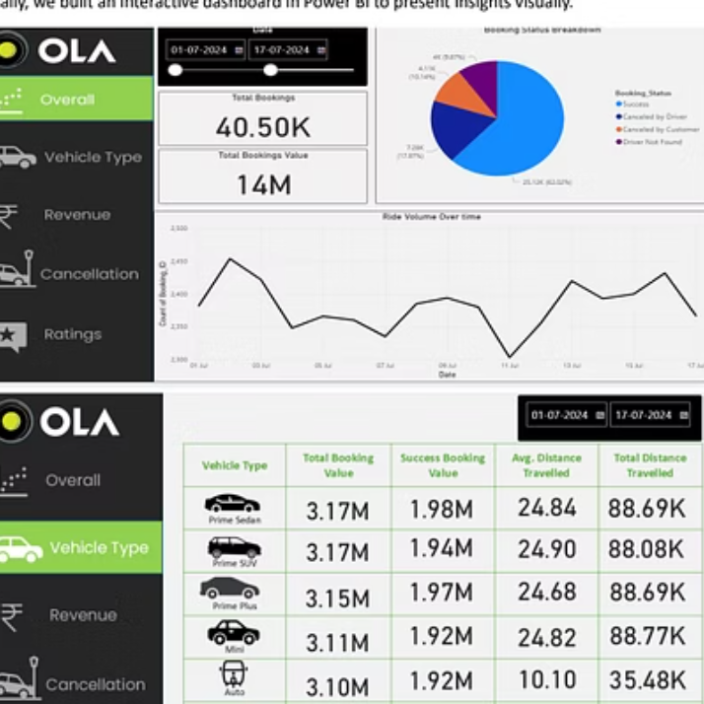
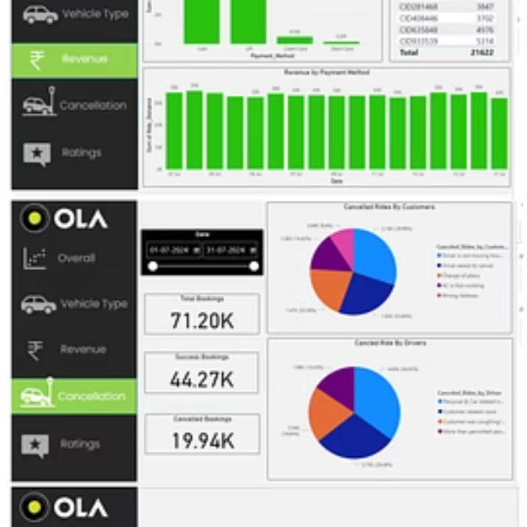
Interactive Dashboard Insights
Power BI dashboard visualizes key metrics: vehicle type distribution, rating trends, cancellation patterns, and revenue performance across booking statuses.

Slide 9
Strategic Recommendations
Fleet Optimization
Reduce Cancellations
Increase Prime SUV and Bike availability based on demand and distance trends.
Provide driver car maintenance support and strengthen customer education on cancellation policies.
Loyalty Programs
Driver Excellence
Offer priority services and discounts to top 5 customers for retention.
Implement training for low-rated drivers, especially in Prime Sedan category.
Payment Incentives
Route Optimization
Promote UPI with cashback offers, leveraging its success in completed transactions.
Deploy drivers strategically on high-traffic routes to minimize wait times.

